Slide 1




Market Organization in Lebanese Microgrids: Insights from Electricity Demand Elasticity and Game-Theory Optimization
Sebastian Zwickl-Bernhard^{1,2}, Anne Neumann^{2,3}, Majd Olleik^{4,} Haytham Dbouk⁵
¹Energy Economics Group (EEG), Technische Universität Wien, Gußhausstraße 25-29/E370-3, 1040 Wien, Austria
²Department of Industrial Economics and Technology Management, The Norwegian University of Science and Technology (NTNU), Sentralbygg 1, 946, Gløshaugen, Trondheim, Norway
³Norwegian School of Economics (NHH), Helleveien 30, 5045 Bergen, Norway
⁴Department of Industrial Engineering and Management (IEM), American University of Beirut, Lebanon
⁵Innovating Green Technology (IGT), Chiyaha, Cheikh Taleb Khalil, Beirut, Lebanon
Internal Meeting / 13 March 2025
Contact: zwickl@eeg.tuwien.ac.at

Slide 2
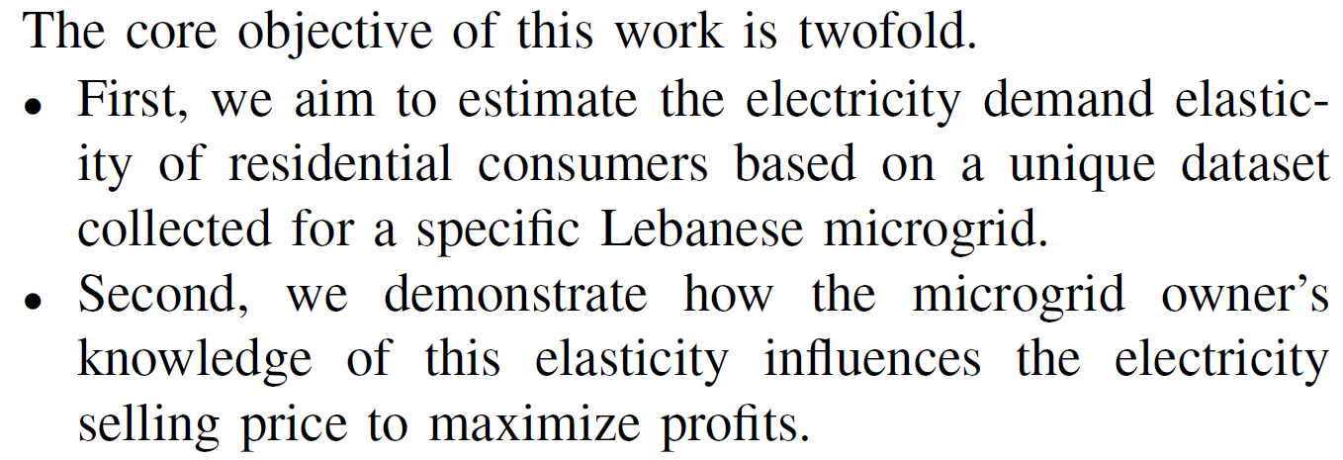

Slide 3
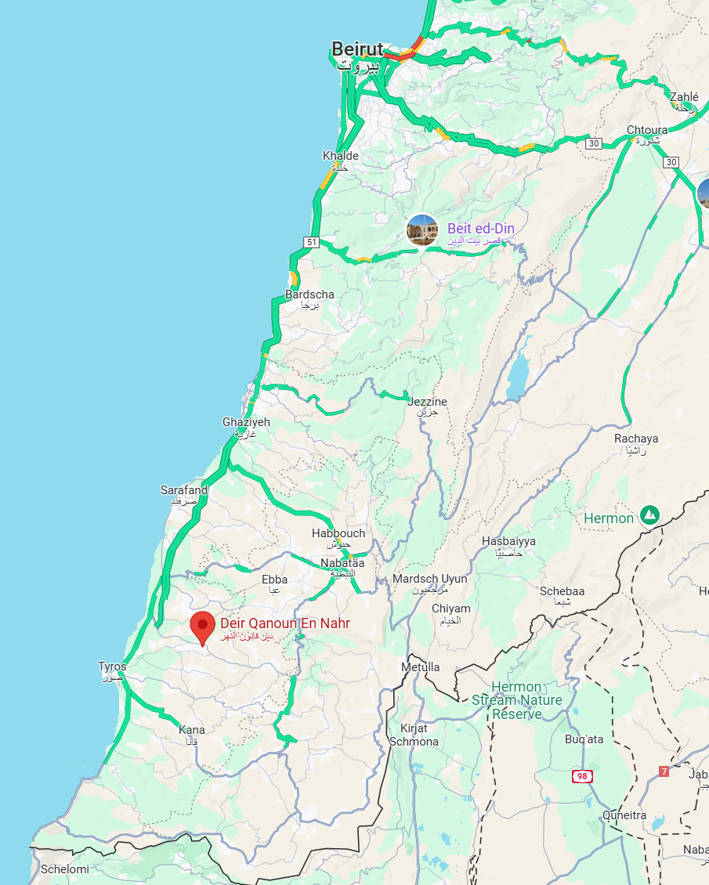
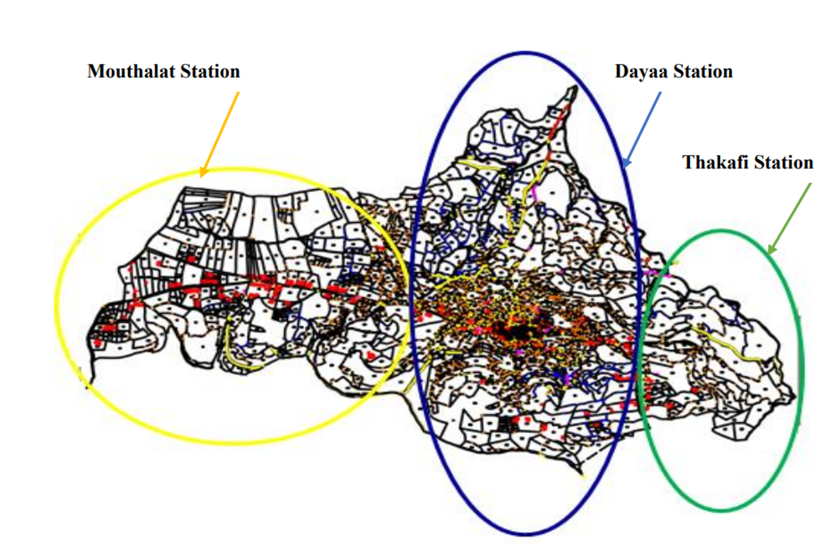
Energy Situation in Deir Kanoun
15,000 inhabitants with 1150 households and 194 commercial/industrial units
Three micro grids (Mouthalat, Dayaa, and Thakafi)

Slide 4
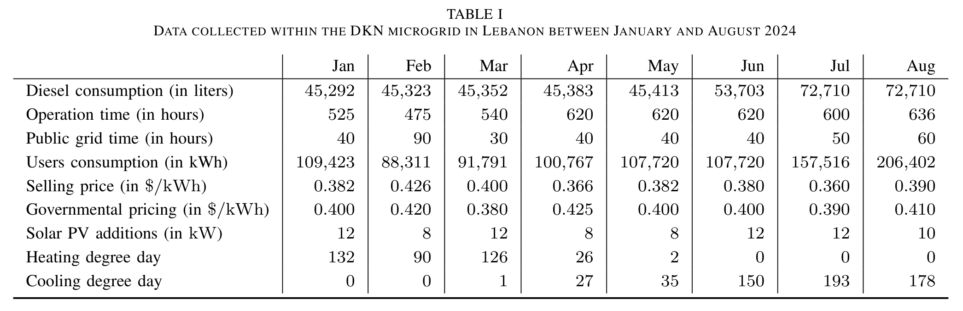
Collected data of the Lebanese microgrid in Deir Kanoun al Naher

Slide 5
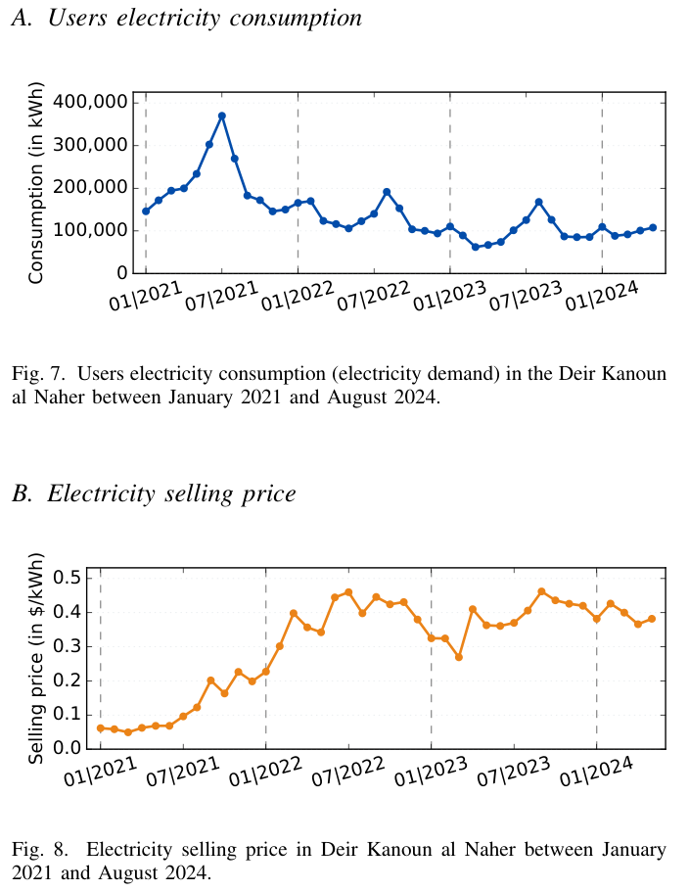
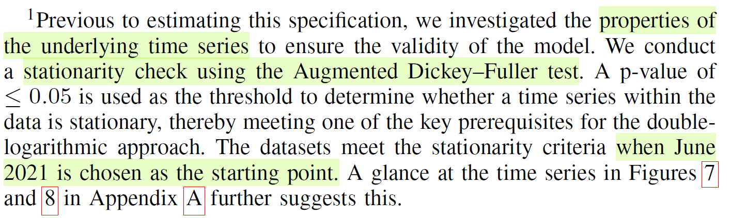
Collected data of the Lebanese microgrid in Deir Kanoun al Naher
A time series is described as stationary if its statistical properties, such as mean value, variance and autocorrelation, remain constant over time (i.e., no trend or seasonal pattern and moves around a fixed mean value.)

Slide 6
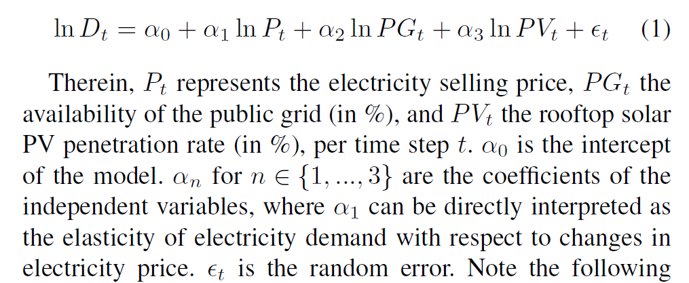
Ordinary least squares estimator

Slide 7
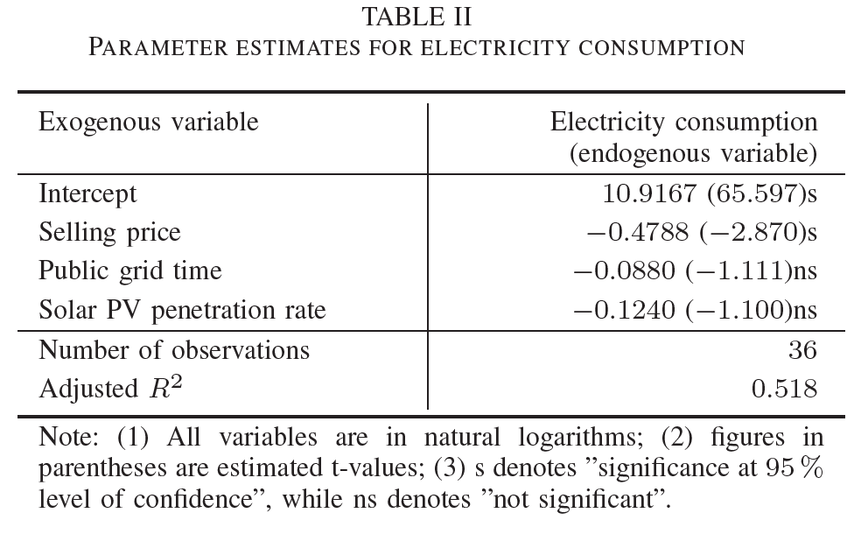
Electricity selling price elasticity is -0.4788 (and significant)

Slide 8
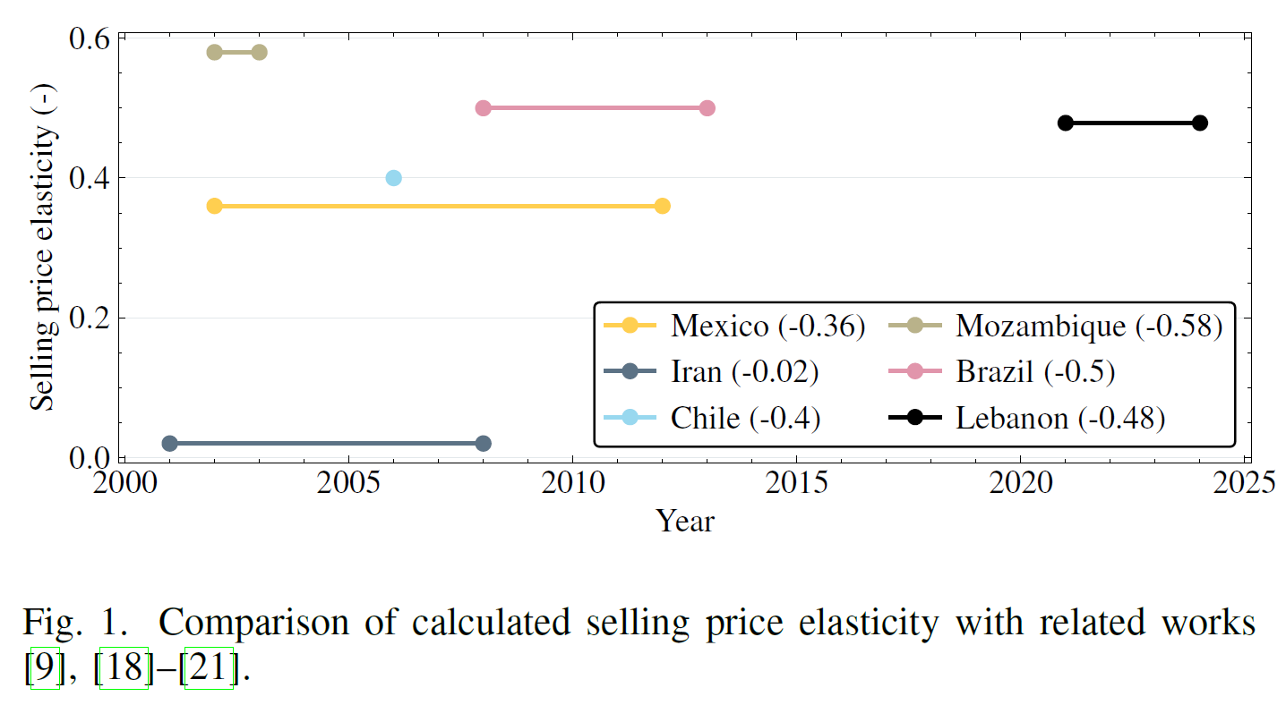
Comparison with relevant studies

Slide 9
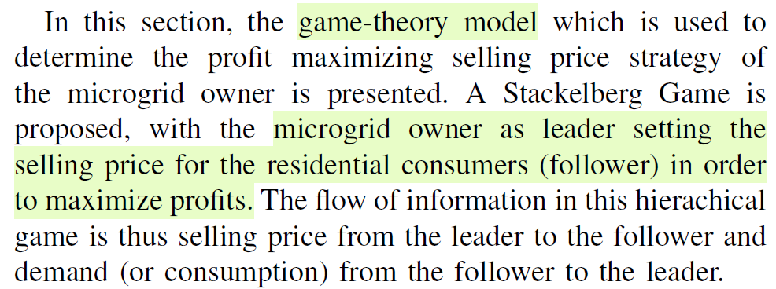
Analyze how the microgrid owner’s knowledge of this elasticity affects electricity pricing to maximize profits

Slide 10
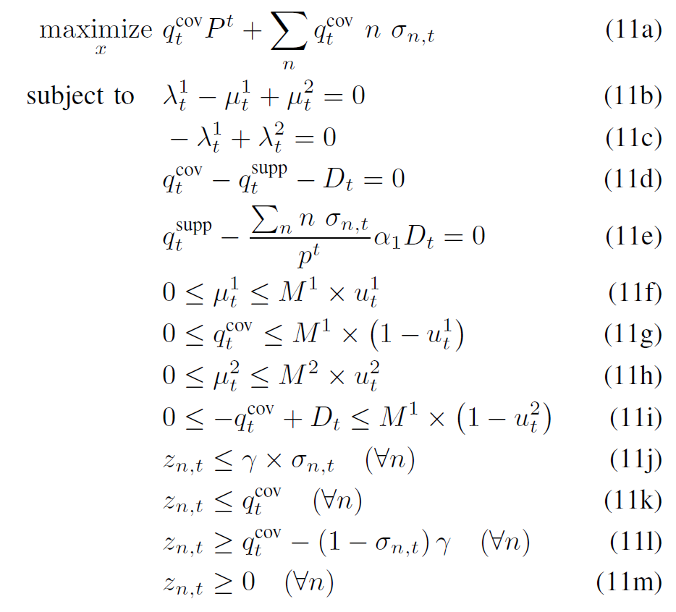

Slide 11
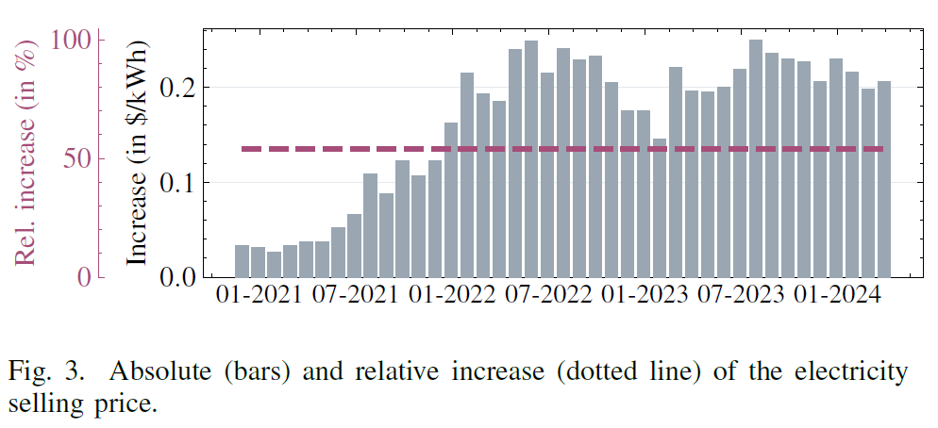
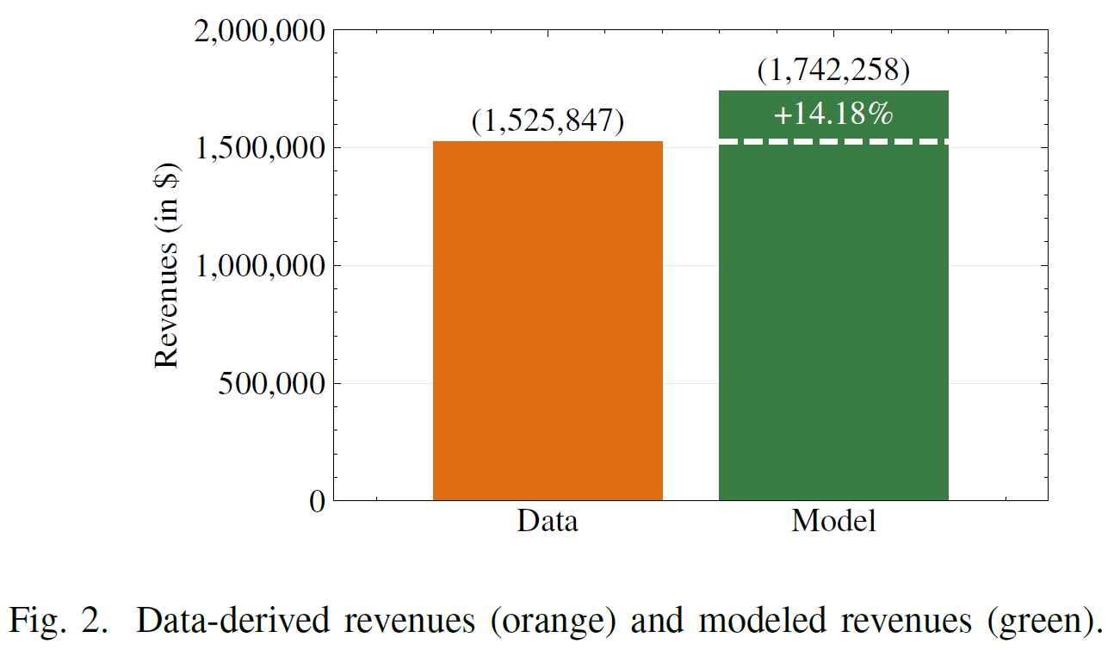
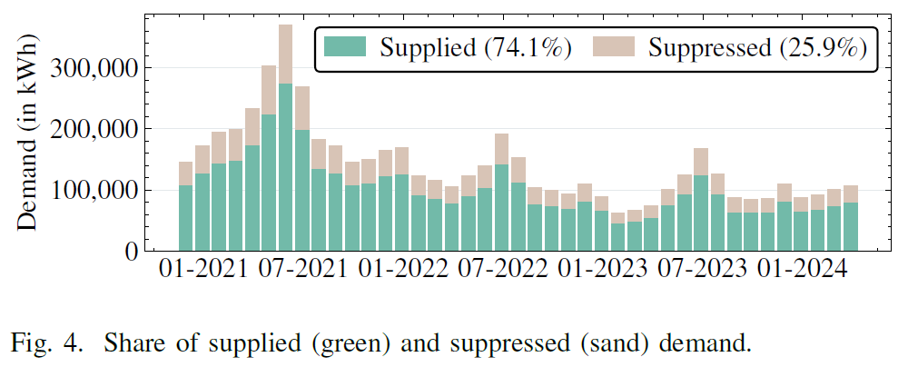

Slide 12
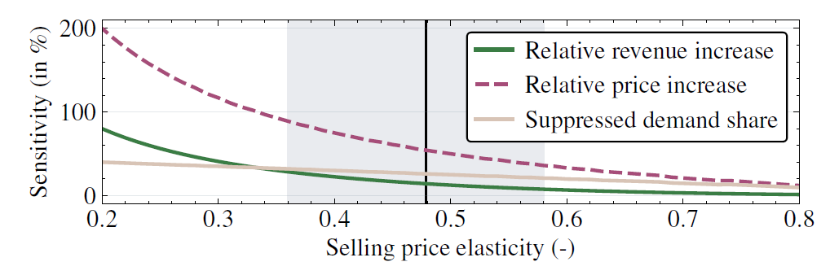
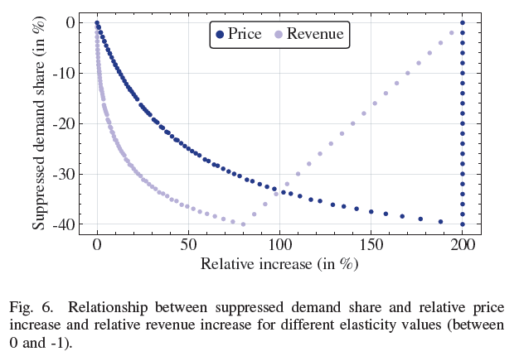
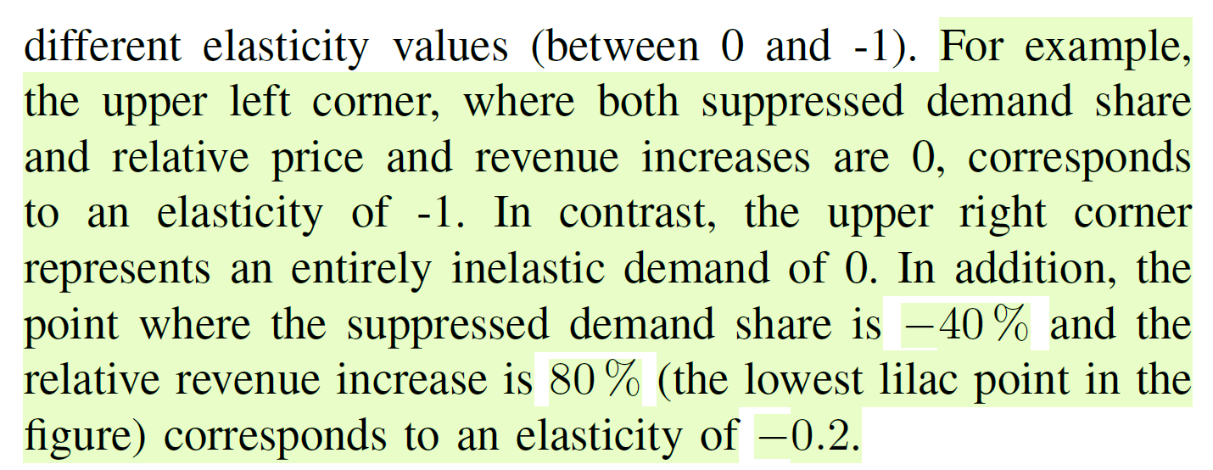

Slide 13
Conclusions
The estimated selling price elasticity is -0.4788, indicating relatively inelastic demand, consistent with values reported in related studies for developing countries.
Notably, public grid time and solar PV penetration rate are not statistically significant in our estimation.
Our findings indicate that when the microgrid owner accounts for the selling price elasticity and incorporates it explicitly into her pricing strategy, leading to a 54% increase, revenues are projected to rise modestly by approximately 15%.
Concurrently, suppressed demand is anticipated to constitute up to 25% of the initial demand.
The conducted sensitivity analysis showed that this share can be lowered through a higher selling price elasticity because it reduces the possibility of a too aggressive pricing strategy in the microgrid because a more careful balance between pricing and supplied met is required.

Slide 14
Future work
The conducted sensitivity analysis showed that this share can be lowered through a higher selling price elasticity because it reduces the possibility of a too aggressive pricing strategy in the microgrid because a more careful balance between pricing and supplied met is required.
These findings raise the question how residents’ demand elasticity can be effectively increased.
Public grid time and solar PV penetration rate (including battery storage systems)

Slide 15

Authors

